Slide 1
Identification of the unknown compounds
(through “Functional Group” analysis)
The following videos show how to do almost all tests
https://www.youtube.com/watch?v=n4esSHxz_J8
https://youtu.be/n4esSHxz_J8?list=TLPQMTcwMzIwMjBcD3rBWPNtXw
An excellent pictorial description of almost all tests can be found at:
https://chem.libretexts.org/Bookshelves/Organic_Chemistry/Book%3A_Organic_Chemistry_Lab_Techniques_(Nichols)/06%3A_Miscellaneous_Techniques/6.03%3A_Chemical_Tests/6.3.0D%3A_6.3D%3A_Individual_Tests
DISCLAIMER: These tests only have historical value. Not used these days. They are not hard & fast – lots of false negatives and positives

Slide 2
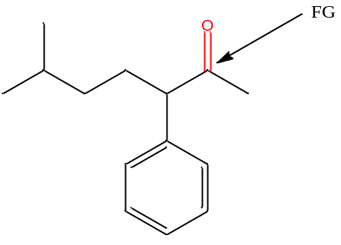
What is a Functional Group?
A functional Group (FG) is a small part of an organic molecule that
that reacts in a chemical reaction. A molecule may have one or
More than one FG.
Some FGs behave independently of others in chemical reactions, but others may undergo interference from other FGs.
Some FGs, though different, may give similar tests. They give “false positive” test.
An FG may give the expected test in one compound, but not in another, it is said to give “false negative” test.

Slide 3
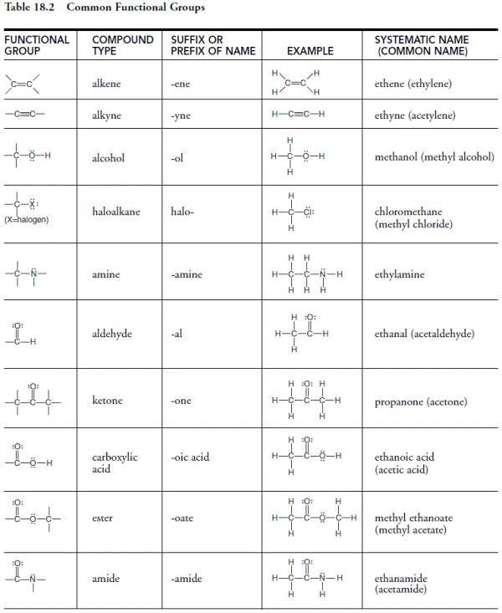


Halogens (Br or Cl) or an ether group may be present in addition to one functional group
nitro compounds
nitro

Slide 4
Preliminary Tests (historical value)
Chemical tests (historical value)
Spectroscopic analysis
(now routinely used)

Slide 5
(A) Preliminary Tests
These are “quick and dirty” tests to have ‘some idea’ of the unknown
(Have a 60 ºC water bath ready for all testes)
Solubility: Amines, and carboxylic acids having four or less than four carbon atoms are soluble in water.
(try dissolving 1-2 drops of the unknown in 1 mL of water by shaking in a tt. If not soluble,
try warming it in water at 60 ºC (have a beaker with water ready on a hot plate). A compound with 4 or
less than 4 carbon atoms with a “hydrogen-bonded FG (OH, NH)” will dissolve in water.
2. Ignition/combustion test: Aromatic compounds are highly unsaturated, therefore they produce a black “soot” when burnt on a spatula in a colorless flame.
https://www.youtube.com/watch?v=vdPlEJSG0UQ
3. Beilstein test: Compounds containing halogens (chlorine and bromine) , given a greenish flame when
heated on a clean copper wire (Cu-wire reacts with oxygen of air to make CuO, which reacts with Cl or Br of
the unknown to make CuCl₂ or CuBr₂ which vaporizes as greenish flame.
https://www.youtube.com/watch?v=WmWUqOFGXsY
4. Litmus test: Compounds containing carboxylic acid groups ( and certain phenols) give red color to the litmus strip, while compounds containing aliphatic amines give blue color to the litmus strip.

Slide 6
(B) Chemical Tests (these confirm a FG)
1. These tests represent chemical reactions of the Functional Groups (FG)
present in the unknown.
2. A FG of an organic molecule reacts with a given reagent to make another compound that may have different color, physical state, different mp and bp etc, as well as different spectroscopic properties (NMR, IR, MS).
3. They can be performed independently and directly on the unknown.

Slide 7
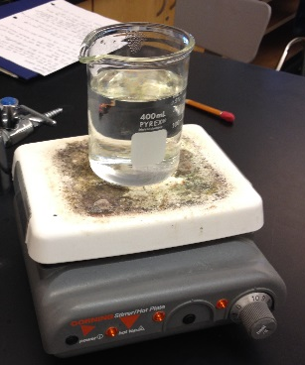

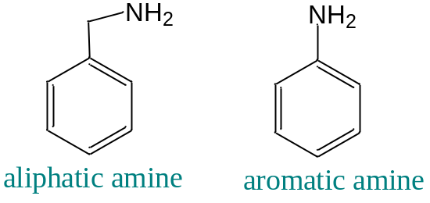
Chemical Tests –cont’d
(Organic Acids and Bases)
Litmus test for carboxylic acid and aliphatic amines
https://www.youtube.com/watch?v=E2xNpSj_A4U
watch at 55 sec-2 min
“Carboxylic acids” dissolved in cold or hot water, give red litmus test”
“Aliphatic amines (not aromatic)” under similar conditions give blue litmus test”

Slide 8
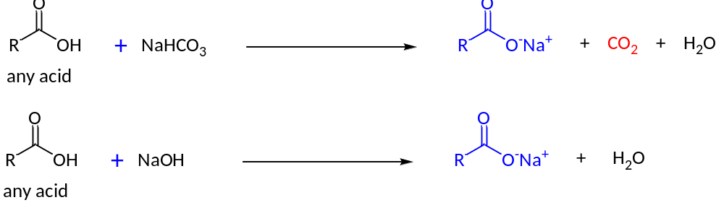
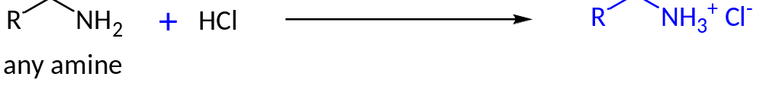
Chemical Tests –cont’d
(Organic Acids and Bases)
https://www.youtube.com/watch?v=E2xNpSj_A4U
watch at 1:00 min
“Carboxylic acids” when reacted with 5% sodium bicarbonate (NaHCO₃) evolve CO₂”
“Carboxylic acids” dissolve in 5% NaOH to form water-soluble salts”
“Aliphatic amines” dissolve in 5% HCl to form water-soluble salts ”

Slide 9
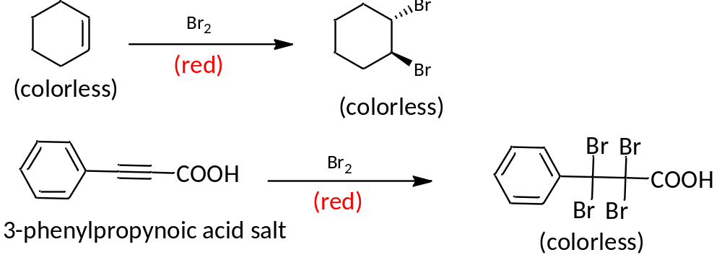
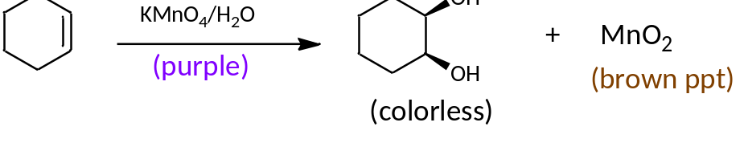
Chemical Tests –cont’d
(Tests of unsaturation for alkenes and alkynes)
“Unsaturated compounds” react with bromine (red) and potassium permanganate solution (purple) to make colorless compounds
https://www.youtube.com/watch?v=2C_6ax2TsV8
https://www.youtube.com/watch?v=E2Tqv1DnwHg&t=17s
Watch from 1:40 min

Slide 10
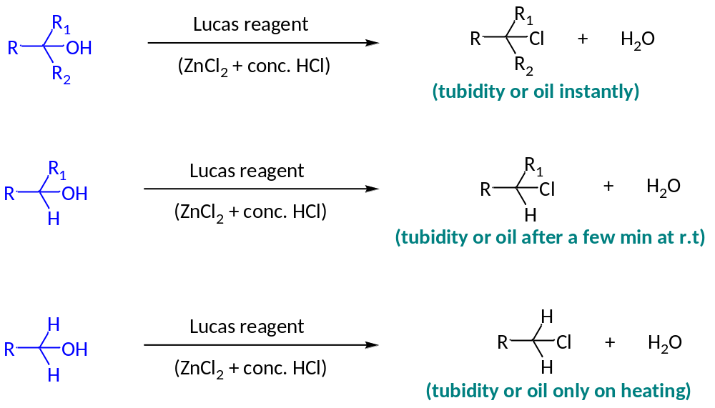
Chemical Tests –cont’d
(alcohols)
Lucas test
https://www.youtube.com/watch?v=4yPjkRLcauI
“The reaction of ZnCl₂+HCl (Lucas reagent) with tert. alcohols produces a white turbidity or oily layer almost instantly; with sec. alcohols, the turbidity appears after a few minutes on standing; with primary alcohols, the turbidity or oily layer occurs only on heating”

Slide 11
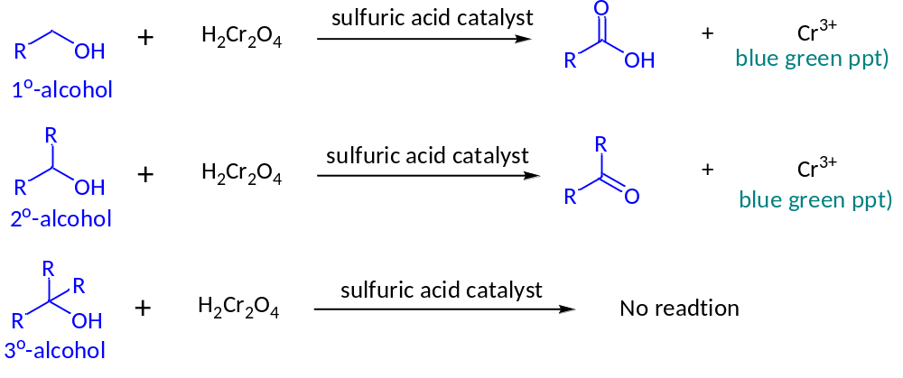
Chemical Tests –cont’d
(alcohols – cont’d) Chromic acid test with jones reagent
https://www.youtube.com/watch?v=ESGPOgXH6DU
Jones reagent

Slide 12
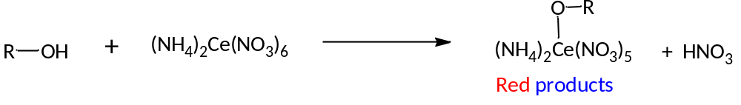
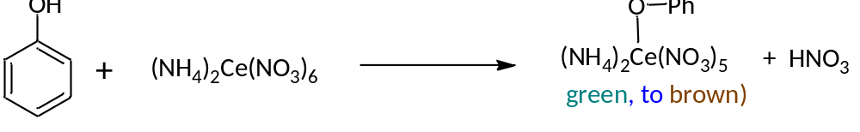
Reaction of alcohols/phenols
with ceric ammonium nitrate
https://www.youtube.com/watch?v=xotWCss9bVI
watch at 3:17 min
Ceric ammonium nitrate
Ceric ammonium nitrate

Slide 13
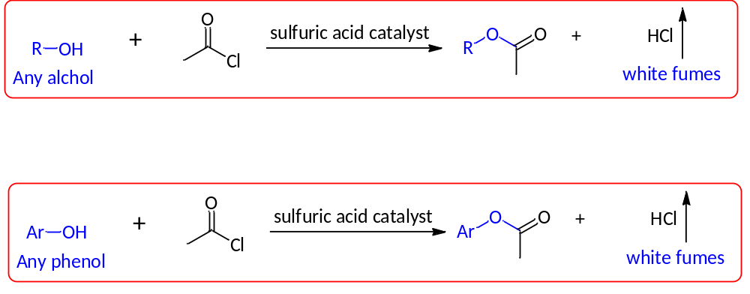
Reaction of alcohols/phenol with acetyl chloride
https://www.youtube.com/watch?v=0D0QKxYKRas
White fumes
intensified
by ammonia
solution
White fumes
intensified
by ammonia
solution

Slide 14
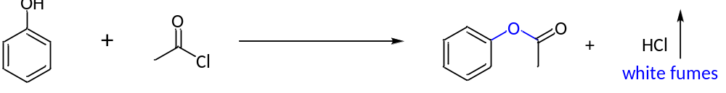
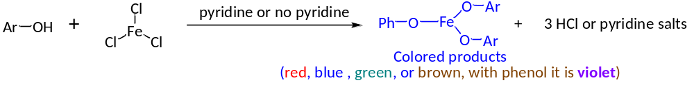
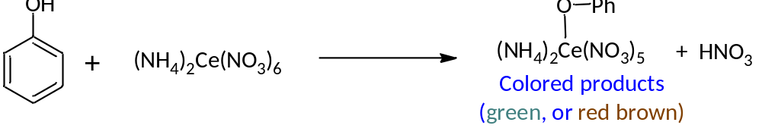
Chemical Tests –cont’d
(Phenols)
https://www.youtube.com/watch?v=HSGlfbV7W84
4 tests = litmus, FeCl₃, Liebermann-nitroso test
Phenols are weak acids; they make litmus paper slightly red; they do not react with sodium bicarbonate (unlike carboxylic acids)
1. Reaction with acetyl chloride
White fumes
intensified
by ammonia
solution
2. Reaction with FeCl₃
3. Reaction with Ceric ammonium nitrate
https://www.youtube.com/watch?v=xotWCss9bVI
watch at 3:17 min

Slide 15
Pyridine is used for water-insoluble phenols
Ferric Chloride test for Phenols. Just as enols can form colored complexes with ferric ion, phenolate ions can as well. Therefore, this test is designed to convert the weakly acidic phenols to their conjugate base which can then complex with ferric ion. If the phenol is water soluble, add a few drops of 2.5% aqueous ferric chloride solution to a 3% aqueous solution of the phenol. A deep red, green, or blue color is positive. If the phenol is not water soluble, dissolve 20 mg of the solid (or 1 drop of the liquid) in 1 mL of methylene chloride and add 1 drop of pyridine. Add 3 drops of 1% ferric chloride in methylene chloride. An intense color is a positive test. Use phenol as a known. Not all phenols will give a positive test.

Slide 16
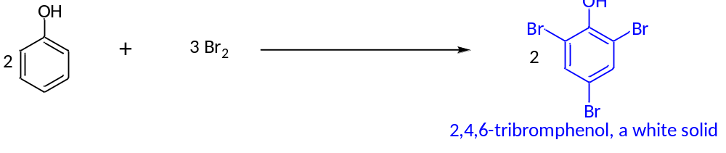
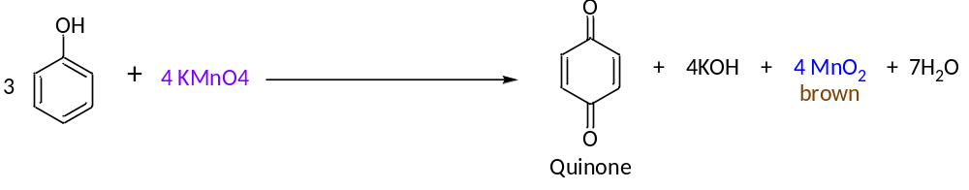
Chemical Tests –cont’d
(Phenols)
1. Reaction with “bromine water”
https://www.youtube.com/watch?v=i98oppx7E-M
2. “Baeyer Test” - Reaction with KMnO₄
False positive: Baer test

Slide 17
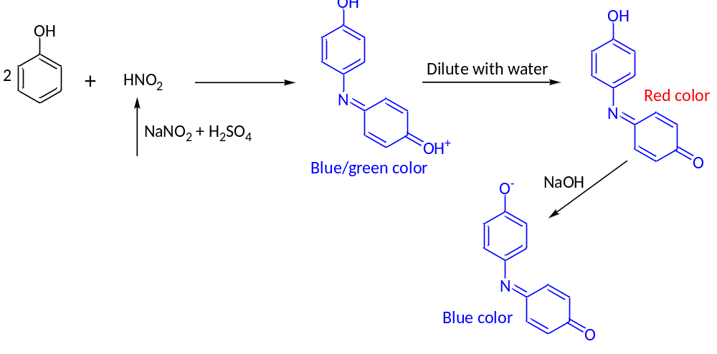
Chemical Tests –cont’d
(Phenols)
Liebermann-nitroso Test for Phenol
https://www.youtube.com/watch?v=HSGlfbV7W84
watch at 2:00 min

Slide 18
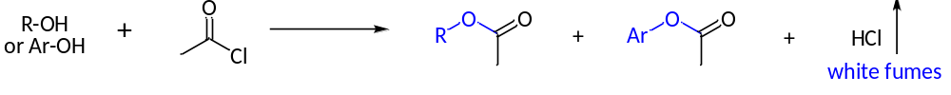
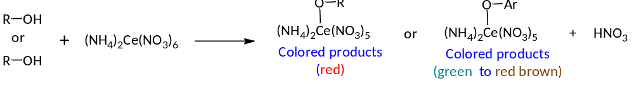
Chemical Tests –cont’d
(Alcohols and Phenols – common tests)
1. Reaction with acetyl chloride
White fumes
intensified
by ammonia
solution
2. Ceric ammonium nitrate test

Slide 19
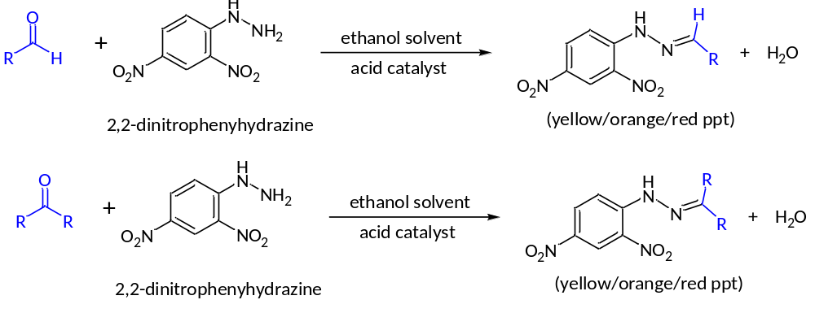
Chemical Tests –cont’d
(aldehydes and ketones – 2,4-DNP test)
https://www.youtube.com/watch?v=YHhCFIsYbuQ
Watch at: 2:20 mi
“The carbonyl compounds (aldehydes and ketone) react with
2,4-dinitrophenylhydrazine (2,4-DNP) to give brightly colored ppts of hydrazones!”

Slide 20
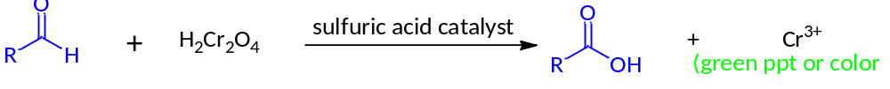
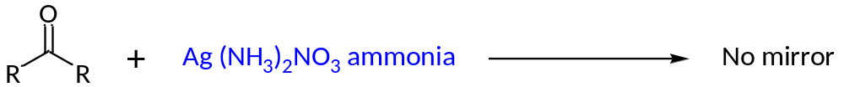
Chemical Tests –cont’d
(differentiation of aldehydes from ketones)
https://www.youtube.com/watch?v=biV1tzpUAwU
Two tests differentiate aldehydes from ketones:
1. Aldehydes with oxidizing agents like chromic acid to give a green color
2. Aldehydes produce a silver mirror with Tollens reagent (ammoniacal silver nitrate)”
3. Ketones do not give the above tests

Slide 21
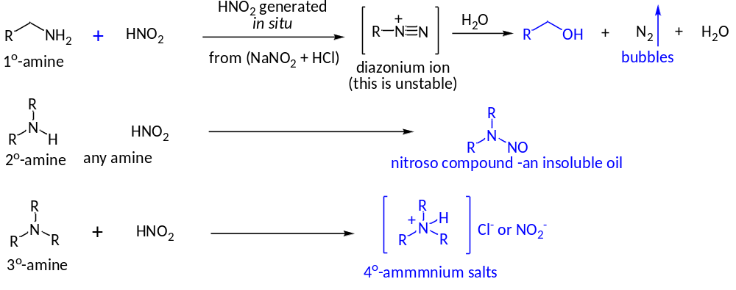
Chemical Tests –cont’d
(Aliphatic amines)
https://www.youtube.com/watch?v=j5jgMUWri8U
Watch from 4:07 min
“Primary aliphatic amines give blue litmus test. They evolve nitrogen gas on reaction with nitrous acid (HNO₂) which is generated in situ from sodium nitrite and HCl. Sec. amines react with HNO₂ to an insoluble oil”. Tert. amines react to produce only salts as clear solutions”.

Slide 22

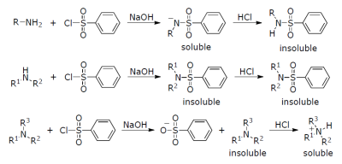
Chemical Tests –cont’d
(Aliphatic and aromatic amines cont’d – Hinsberg Test)
https://www.youtube.com/watch?v=SZ4ILp95x7g
“Hinsberg Test can distinguish between º1, º2, and º3 amines”. An amine is reacted with benzene sulfonyl chloride. If a product forms, the amine is either a primary or secondary amine, because tertiary amines do not form stable sulfonamides. If the sulfonamide that forms dissolves in aqueous sodium hydroxide solution, it is a primary amine. If the sulfonamide is insoluble in aqueous sodium hydroxide, it is a secondary amine. The sulfonamide of a primary amine is soluble in an aqueous base because it still possesses an acidic hydrogen on the nitrogen, which can be lost to form a sodium salt.

Slide 23
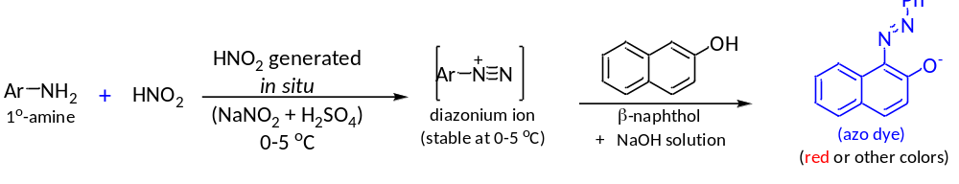
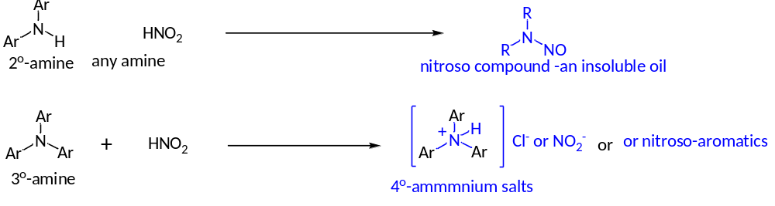
Chemical Tests –cont’d
(Aromatic amines)
https://www.youtube.com/watch?v=SZ4ILp95x7g
“Primary aromatic amines DO NOT give blue litmus test. They DO NOT evolve nitrogen gas at low temp on reaction with nitrous acid (HNO₂) which is generated in situ from sodium nitrite and HCl.
Sec. amines react with HNO₂ to form insoluble oil”. Tert. amines either do not react or produce only nitroso aromatics”.

Slide 24
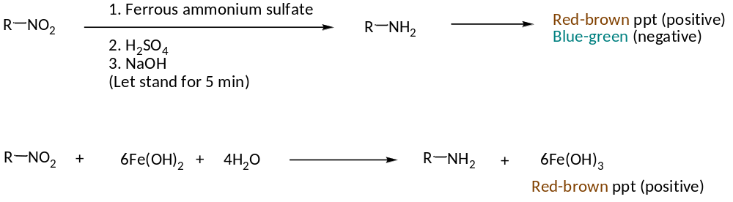
Chemical Tests –cont’d
(Nitroalkanes and Nitroarenes)
Ferrous Hydroxide Test
The following is one of the rarest classical test for esters which produces red-brown ppt with nitro compounds.

Slide 25
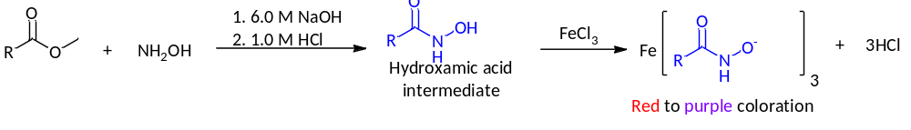
Chemical Tests –cont’d
(Esters)
Ferric hydroxamate Test
Many esters have pleasant odors! The following is one of the rarest classical test for esters. Hydroxylamine reacts with esters to form hydroxamates which give colored complexes (e.g, red to purple) with ferric chloride.

Slide 26
(C) Spectroscopic Tests
Spectroscopic analysis has taken over almost completely
the Classical FG analysis
For H-NMR frequency tables:
https://www.cpp.edu/~lsstarkey/courses/NMR/NMRshifts1H-general.pdf
For Infrared frequency tables:
https://www.sigmaaldrich.com/technical-documents/articles/biology/ir-spectrum-table.html
For MS analysis (not used in this lab):
https://users.wfu.edu/~kingag/223L/procedures-handouts/common%20MS%20fragment%20ions.pdf

Slide 27
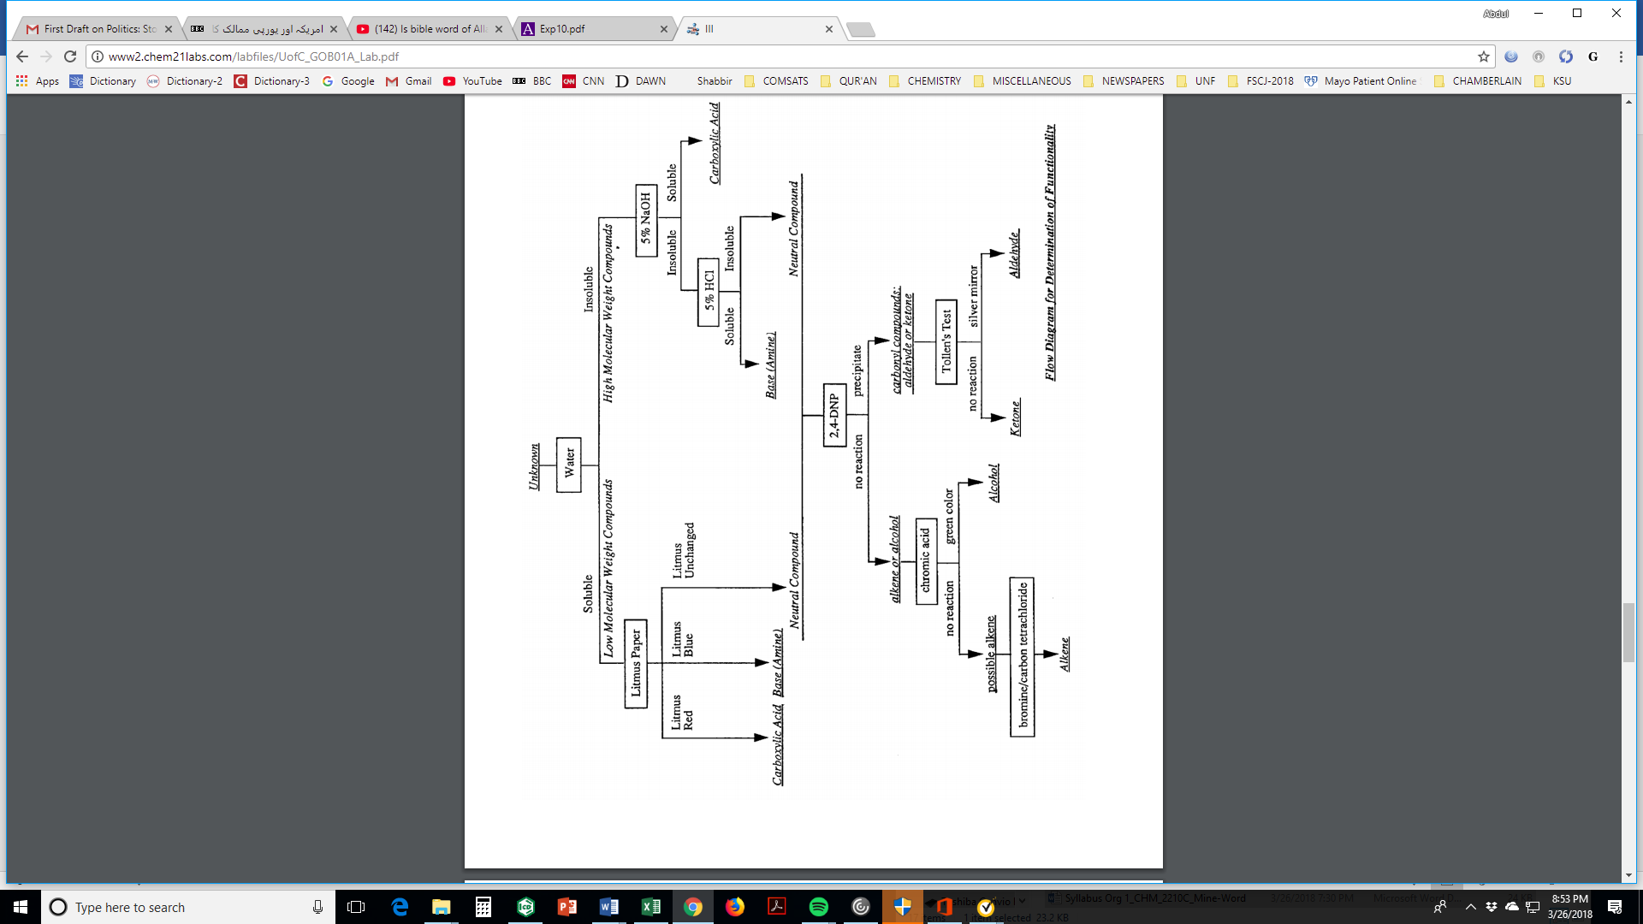
Unknown organic compound
(warm to 60-70 ºC)
nitro compound
(test further)
or alkene
or aldehyde

Slide 28
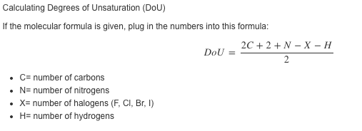
(D) Unsaturation Number
(Degree of Unsaturation)
You will need this to figure out the full structural formula of your unknown.
It measures deficiency of H-atoms in a molecule from fully saturated state

Slide 29
Unsaturation Number
(Degree of Unsaturation)
Solved example: Find out the DoU in C₉H₈Br₂O₂
C9H6O2
2 (9) + 2 + 0 – 2 - 8
DoU =
=
5
2
Find out the DoU in C₉H₆O₂
Find out the DoU in C₆H₁₅N
Find out the DoU in C₈H₁₁N

Slide 30
1. You will be working in pairs as usual
Each hood contains chemicals and waste
bottles for a specific FG or test.
3. You can occupy your usual hood, start direct chemical tests for the FG of the “known” for that hood.
4. After that, you will move to the next hood in an anticlockwise fashion

